Slide 1
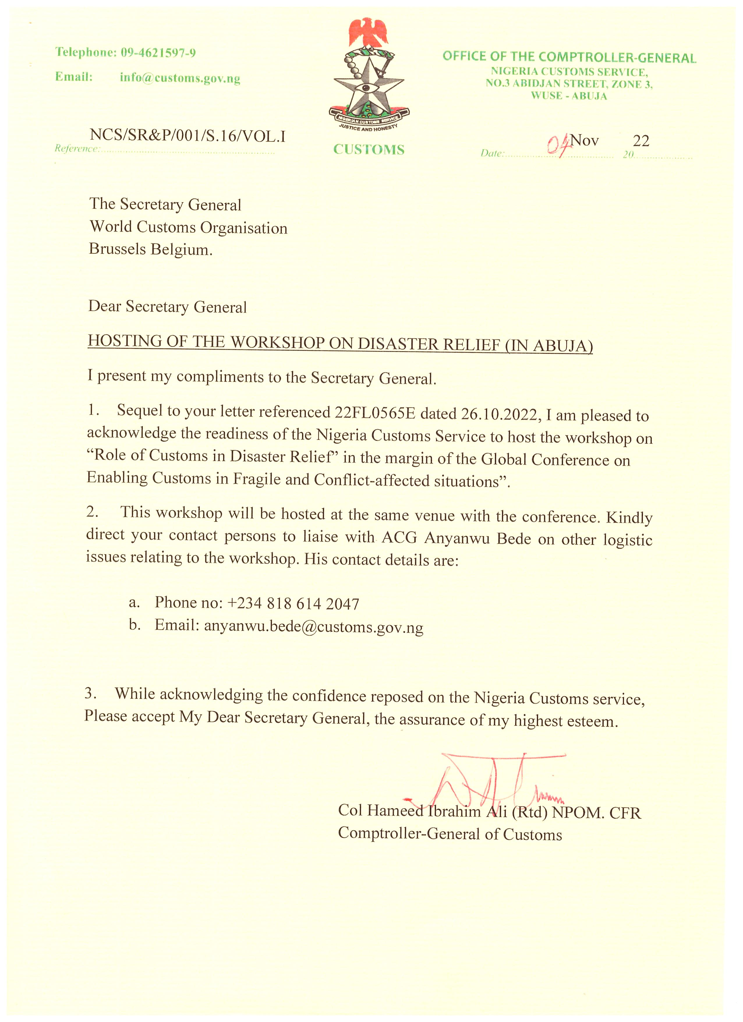
A Report on Fund Utilization for Regional Activities
BY THE REGIONAL FUND MANAGER
AT THE EXPERTS COMMITTEE MEETING IN BANJUL, GAMBIA
MAY 2023

Slide 2
A BRIEF INTRODUCTION ABOUT THE REGIONAL FUND MANAGER AND THE PURPOSE OF THE REGIONAL FUND MANAGER
Hello everyone, my name is Clara Atari Ipigansi-Olagbaju. I am a superintendent in the Nigeria Customs Service and I am the Regional Fund Manager for WCO-WCA.
I want to thank the Chairman for giving me the opportunity to give this Report on Fund Utilization for Regional Activities.
The Regional account is domiciled in Nigeria and is managed by the Comptroller General of the Nigeria Customs Service.
This account is funded through annual contributions made by member administrations based on the Gross Domestic Product (GDP) of each country.
These contributions are required to come from the month of January every year and settlements of the contributions are done exclusively through bank transfers to the Regional Fund Account.

Slide 3
RESPONSIBILITIES OF THE REGIONAL FUND MANAGER
Some of the core functions of the Regional Fund Manager include:
Works closely with the office of the Vice Chair to implement regional customs projects and initiatives
Effectively Manage the financial resources of the region
Ensuring that financial transactions of the regional account are properly recorded and reported.
Providing financial report to the Secretariat and the finance committee
Update and reconcile the contributions made by member countries against the swift and statement received from the bank.
Signatory to the Regional Fund account.
Serve as member of the Finance and Audit Committee of West and Central Africa where necessary

Slide 4
EXPECTATIONS FROM REGIONAL STRUCTURES
Regional Structures are expected to make their annual contributions using the details provided below:
Beneficiary Bank: Ecobank Nigeria Limited
Beneficiary Bank Swift Code: ECOCNGLA
Beneficiary Account Name: WCO West and Central Africa Region
Beneficiary Account No: 1282007045
Currency: EUR
Bank transfer charges: OUR
Intermediary Bank: Deutsche Bank AG Frankfurt Main Germany
Account of Ecobank with intermediary: 955700000
Intermediary Bank Swift Code: DEUTDEFF

Slide 5
Amount specified as it relates to each regional structure.
Details: Annual contribution for the relevant year.
All payments made should clearly state details such as the name of the country and the year for which contribution is being made. This makes reconciliation very easy
Member administrations must send swift copies of the bank transfer made to the Vice-Chairperson and the Regional Fund Manager.
Payment of contributions will only be acknowledged when the payment hits the regional account and is credited.

Slide 6
ANNUAL CONTRIBUTIONS RECEIVED FOR THE YEAR 2023
COUNTRY | AMOUNT | DATE | YEAR
BURKINA FASO | €13,500.00(6,500) | 02.03.2022 | 2023
 | €10,000.00 | 14.10.2022
 | €10,000.00 | 17.10.2022
NIGER NIAMEY | €13,500.00 | 10.03.2023 | 2023
GABON LIBREVILLE | €13,690.00 | 29.03.2023 | 2023
CAPE VERDE | €10,000.00 | 31.03.2023 | 2021
COTE D’IVOIRE | €10,000.00 | 11.04.2023 | 2023
CONGO KINSHASHA | €17,000.00 | 13.04.2023 | 2023
NIGERIA | €29,500.00 | 17.04.2023 | 2023
SIERRA LEONE | €12,OOO.OO | 26.04.2023 | 2023
TOTAL | €145,690.00

Slide 7
SUMMARY OF FUND REQUESTS RECEIVED FROM REGIONAL STRUCTURES FROM 31ST MAY 2022 TILL DATE
NAME OF REGIONAL STRUCTURE | NUMBER OF REQUESTS MADE | CUMMULATIVE FUND REQUESTED IN EUROS
RILO WA | 7 | 28,066
RILO CA | 9 | 63,251
ROCB ABIDJAN | 18 | 55,641
RTC BRAZZAVILLE | 3 | 11,240
RTC ABUJA | 4 | 72,100
AUDIT COMMITTEE | 6 | 29,560
RTC OUAGADUGUO | 2 | 6,505
OFFICE OF VICE CHAIR | 1 | 2,900
TOTAL | 50 | 269,263

Slide 8
CONCLUSSION AND RECOMENDATIONS
While making payments for annual contributions, it is important that the remark is clearly stated ie what country is making the payment and the year the contribution is for (. This will make it easy for reconciliations.
Fund requests are to be sent to the office of the Vice-Chair 2 weeks before the intended mission so as to allow ample time for processing of the payment.
When fund requests are received by regional structures it is important to send feedback to the Regional Fund Manager

Slide 9
JUSTIFICATIONS FOR FUNDS RELEASED FROM 30TH MAY 2022 TILL DATE
1 | ROCB ABIDJAN | 49/WCO-WCA | 30-05-2022 | SANGHO ABDEL KADER | 4000 EUROS | FOR PARTICIPATION IN THE ANNUAL COUNCIL SESSION
2 | ROCB ABIDJAN | 007/WCO-WCA | 1.12.2022 | SANGHO ABDEL KADER | 3000 EUROS | FOR TECHNICAL ASSISTANCE MISSIONS FOR MEMBERS
3 | ROCB ABIDJAN | 008/WCO-WCA | 1-12-2022 | GNANAGO KOKORA ABY HARDING | 3000 EUROS | FOR TECHNICAL ASSISTANCE MISSIONS FOR MEMBERS
4 | RILO WA | 004/WCO-WCA | 19-09-2022 | BIRAME SIDY KANE | 4000 EUROS | GLOBAL INFORMATION AND INTELLIGENCE STRATEGY MEETING (OCTOBER 6-7, 2022) | 11.8
5 | BRRC-AOC | 005/WCO-WCA | 22-09-2022 | SANGHO ABDEL KADER | 3000 EUROS | FOR PARTICIPATION IN THE 11TH REGIONAL MEETING OF TRAINING AND HUMAN RESOURCE MANAGERS IN OCTOBER 12-14, 2022 IN ABUJA | 9.1

Slide 10
6 | BRRC-AOC | 006/WCO-WCA | 22-09-2022 | GANIYOU LATIFOU | 3000 EUROS | FOR THE 11TH REGIONAL ACCOUNT MEETING OF TRAINING AND HUMAN RESOURCES MANAGERS OCTOBER 12-14, 2022 IN ABUJA | 9.1
7 | AUDIT COMMITTEE | /WCO-WCA | 20-09-2022 | ABDOULAYE NDIAYE | 4900 EUROS | FOR AUDIT OF REGIONAL STRUCTURES
8 | AUDIT COMMITTEE | /WCO-WCA | 03-10-2022 | ALHAJIE SAIHOU DENTON | 6100 EUROS | FOR AUDIT OF REGIONAL STRUCTURES | 14.4
9 | AUDIT COMMITTEE | /WCO-WCA | 28-09-2022 | EDWIN F.E CONTEH | 6100 EUROS | FOR AUDIT OF REGIONAL STRUCTURES
10 | AUDIT COMMITTEE | /WCO-WCA | 28-09-2022 | L.DANIEL JAIBLAI | 3900 EUROS | FOR AUDIT OF REGIONAL STRUCTURES

Slide 11
11 | BRRC-AOC | 004/WCO-WCA | 20-10-2022 | SANGHO ABDEL KADER | 3000 EUROS | FOR THE 13TH MEETING OF POINTS OF CONTACT SCHEDULED FOR 9 TO 11 NOVEMBER 2022 AT YAOUNDE, CAMEROON | 10.2
12 | BRLR-AC | /OMD-AOC | 1-11-2022 | M. NJOYA NJIMOLUH IBRAHIM | 3,163 EUROS | 13TH ANNUAL JOINT MEETING OF THE NATIONAL CORRESPONDENTS OF RILO WEST AND CENTRAL AFRICA SCHEDULED FOR NOVEMBER 13 TO 19 2022 IN DAKAR, SENEGAL. | 10.5

Slide 12
13 | RTC ABUJA | /WCO-WCA | 29-12-2022 | KENNETH OMOROGBE OLOWO | 3,100 EUROS | BUDGETARY SESSION OF FINANCE COMMITTEE | 12.1 AND 10.3
14 | OVC | 01/WCO-WCA | 03-01-2023 | NSIKAN UMOH | 2,900 EUROS | SIMULTANEOUS INTERPRETATION IN ENGLISH, FRENCH AND PORTUGUESE / HOSTING OF ZOOM PLATFORM FROM THE REGIONAL FUND ACCOUNT USING BUDGET | CODE 12.1

Slide 13
15 | RILO WA | /WCO-WCA | 29-12-2022 | BIRAME SIDY KANE | 2,482 EUROS | FOR BUDGETARY SESSION OF THE FINANCE COMMITTEE | 11.7 (LINE NOT USED BECAUSE OF VIRTUAL MEETING]
16 | BRRC-AOC | 017/REVUE/WCO-WCA | 30-12-2022 | SANGHO ABDEL KADER | 3,062 EUROS | FOR THE BUDGETARY SESSION OF FINANCE COMMITTEE IN GUINEA CONAKRY FROM THE 14-16 DECEMBER 2022 | 11.4
17 | BRLR-AC | /OMD-AOC | 30-12-2022 | M. NJOYA NJIMOLUH IBRAHIM | 3,142 EUROS | FOR THE BUDGETARY SESSION OF FINANCE COMMITTEE IN GUINEA CONAKRY FROM THE 14-16 DECEMBER 2022 | 11.7(LINE NOT USED BECAUSE OF VIRTUAL MEETING]

Slide 14
18 | BRRC-AOC | 008/WCO-WCA | 01-12-2022 | GNANAGO KOKORA ABY HARDING | 3000 EUROS | FOR THE TECHNICAL ASSISTANCE MISSIONS FOR MEMBERS FROM 19 TO 21 DECEMBER 2022 | 9.1
19 | BRRC-AOC | 007/WCO-WCA | 01-12-2022 | SANGHO ABDEL KADER | 3000 EUROS | FOR TECHNICAL ASSISTANCE MISSION TO CONGO CUSTOMS FROM 19 TO 21 DECEMBER 2022 | 9.1
20 | CRF-OUAGADOUGOU | /OMD-AOC | 05-12-2022 | SAWADOGO CASIMIR | 2,630 EUROS | FOR THE BUDGETARY SESSION OF FINANCE COMMITTEE IN GUINEA CONAKRY FROM THE 14-16 DECEMBER 2022 | 7.5 AND 12.1
21 | BRLR-AC | /OMD-AOC | 04-01-2023 | M. ESAMBA BOKEL POKA JEAN PAUL | 4,000 EUROS | FOR THE MEETING OF THE CENMAT MANAGEMENT GROUP | 11.5

Slide 15
22 | BRLR-AC | /OMD-AOC | 04-01-2023 | M. NJOYA NJIMOLUH IBRAHIM | 4,000 EUROS | FOR THE MEETING OF THE CENMAT MANAGEMENT GROUP | 11.6
23 | RILO WA | /WCO-WCA | 04-01-2023 | BIRAME SIDY KANE | 4,000 EUROS | ANNUAL MEETING OF RILOs/ CEN (CENMAT]MANAGEMENT TEAM MEETING | 11.5 AND 11.6
24 | BRLR-AC | /OMD-AOC | 09-01-2023 | M. NJOYA NJIMOLUH IBRAHIM | 35,000 EUROS | FOR ALAMBA 3-ALAFI | 10.17
25 | RTC/BRAZZAVILLE | 010/WCO-WCA | 13-01-2023 | TSEKET GOMEZ | 4,500 EUROS | FOR MEETING OF THE FINANCE AND THE AUDIT COMMITTEE IN GUINEA CONAKRY | 7.5 AND 12.1

Slide 16
26 | RTC/BRAZZAVILLE | 011/WCO-WCA | 20-01-2023 | TSEKET GOMEZ | 3,870 EUROS | FOR THE 18TH GLOBAL MEETING OF DIRECTORS OF REGIONAL CAPACITY BUILDING OFFICES (ROCB], REGIONAL TRAINING CENTERS (RTCs] AND VICE PRESIDENT’S OFFICES AND 14TH SESSION OF THE CAPACITY BUILDING COMMITTEE | 11.2
27 | BRRC-AOC | 001-23/WCO-WCA | 23-01-2023 | SANGHO ABDEL KADER | 3,492 EUROS | FOR THE 14TH SESSION OF CAPACITY BUILDING FROM FEBRUARY 22 TO 24,2023 IN BRUSSELS | 11.2
28 | BRRC-AOC | 002-23/WCO-WCA | 23-01-2023 | GNANAGO KOKORA ABY HARDING | 3,228 EUROS | FOR THE 18TH GLOBAL MEETING OF REGIONAL STRUCTURES FROM MONDAY 22ND -24TH FEBRUARY,2023 IN BRUSSELS | 11.11

Slide 17
29 | CRF-OUAGADOUGOU | /WCO-WCA | 23-01-2023 | SAWADOGO CASIMIR | 3,785 EUROS | FOR THE 18TH GLOBAL MEETING OF REGIONAL STRUCTURES FROM MONDAY 22ND -24TH FEBRUARY , 2023 IN BRUSSELS | 11.2
30 | RILO WA | /WCO-WCA | 24-01-2023 | BIRAME SIDY KANE | 3,700 EUROS | FOR THE 18TH GLOBAL MEETING OF REGIONAL STRUCTURES FROM MONDAY 22ND-24TH FEBRUARY,2023 IN BRUSSELS | 11.11
31 | RTC ABUJA | /WCO-WCA | 25-01-2023 | KENNETH OMOROGBE OLOWO | 4,000 EUROS | FOR RKC MANAGEMENT COMMITTEE CONFERENCE | 11.3

Slide 18
32 | FINANCE COMMITTEE | /WCO-WCA | 29-01-2023 | ALHAJIE SAIHOU DENTON | 4,205 EUROS | FOR FINANCE COMMITTEE WORK MISSION IN ABUJA RE 2022 | 14.1
33 | AUDIT COMMITTEE | /WCO-WCA | 26-01-2023 | EDWIN F.E CONTEH | 4,355 EUROS | FOR FINANCE COMMITTEE WORK MISSION IN ABUJA RE 2022 | 14.3
34 | RTC/BRAZZAVILLE | 010/WCO-WCA | 13-01-2023 | TSEKET GOMEZ | 3,100 EUROS | FOR MEETING OF FINANCE COMMITTEE AND AUDIT COMMITTEE | 7.5 AND 12.1
35 | BRRC-AOC | 003-23/WCO-WCA | 13-02-2023 | GANIYOU LATIFOU | 3,380 EUROS | FOR PARTICIPATION IN THE MANAGEMENT COMMITTEE OF THE REVISED KYOTO CONVENTION 31 FROM 06 TO 10 MARCH 2023 IN BRUSSELS | 11.3

Slide 19
36 | RILO WA | /WCO-WCA | 09-02 2023 | BIRAME SIDY KANE | 3,838 EUROS | FOR ENFORCEMENT COMMITTEE MEETING | 11.7
37 | RILO WA | /WCO-WCA | 17-02-2023 | BIRAME SIDY KANE | 7,946 EUROS | FOR NATIONAL TRAINING WORKSHOPS ON INTELLIGENCE IN MAURITANIA | 9.2
38 | RILO-CA | /WCO-WCA | 31-01-2023 | M. NJOYA NJIMOLUH IBRAHIM | 3,100 EUROS | FOR 18TH GLOBAL REGIONAL STRUCTURE MEETING | 11.11
39 | RILO CA | /WCO-WCA | 28-02-2023 | M. NJOYA NJIMOLUH IBRAHIM | 4,000 EUROS | FOR ENFORCEMENT COMMITTEE MEETING | 11.7

Slide 20
40 | RTC ABUJA | /WCO-WCA | 10-03-2023 | KENNETH OMOROGBE OLOWO | 74,966 EUROS | FOR THE ORGANIZATION OF REGIONAL WORKSHOP ON DATA COLLECTION AND ANALYTICS | 10.10
41 | BRRC-AOC | 005-23/WCO-WCA | 14-03-2023 | GNANAGO KOKORA ABY HARDING | 2,888 EUROS | FOR TECHNICAL ASSISTANCE MISSION TO THE CUSTOMS AND INDIRECT TAXES ADMINISTRATION OF THE CENTRAL AFRICA REPUBLIC FROM MARCH 27 TO APRIL 31,2023 | 9.1
42 | BRRC-AOC | 004-23/WCO-WCA | 14-03-2023 | SANGHO ABDEL KADER | 2,888 EUROS | FOR TECHNICAL ASSISTANCE MISSION TO THE CUSTOMS AND INDIRECT TAXES ADMIN ISTRATION OF THE CENTRAL AFRICA REPUBLIC FROM MARCH 27 TO APRIL 31,2023 | 9.1
43 | RILO WA | /WCO-WCA | 24-03-2023 | BIRAME SIDY KANE | 2,100 EUROS | FOR REGIONAL EXPERTS COMMITTEE AND CONFERENCE OF DIRECTORS GENERALS | 10.4

Slide 21
44 | RILO CA | /WCO-WCA | 30-03-2023 | NJOYA NJIMOLUH IBRAHIM | 3,846 EUROS | FOR REGIONAL EXPERTS COMMITTEE AND CONFERENCE OF DIRECTORS GENERALS | 10.1
45 | RTC/BRAZZAVILLE | 012/WCO-WCA | 04-04-2023 | TSEKET GOMEZ | 4,270 EUROS | FOR THE 29TH CONFERENCE OF DIRECTORS GENERAL OF CUSTOMS IN THE WCA REGION | 10.1
46 | RTC ABUJA | /WCO-WCA | 05-04-2023 | KENNETH OMOROGBE OLOWO | 3,950 EUROS | FOR REGIONAL EXPERTS COMMITTEE AND CONFERENCE OF DIRECTORS GENERALS | 10.1
47 | BRRC-AOC | NO 015/WCO-WCA REF: N 006-21/OMD-AOC | 01-12-2022 | SANGHO ABDEL KADER | 887 EUROS | FOR ANIMATION AND MAINTENANCE OF THE REGIONAL WEBSITE | 8.1
48 | BRRC-AOC | NO 016/WCO-WCA REF:N 021/OMD-AOC | 01-12-2022 | SANGHO ABDEL KADER | 2,882 EUROS | FOR TECHNICAL MISSION FOR MEMBERS | 9.1

Slide 22
49 | BRRC-AOC | NO 014/WCO-WCA REF:N 001-21/OMD-AOC | 01-12-2022 | SANGHO ABDEL KADER | 1,950 EUROS | FOR PRINTER AND PHOTOCOPIER , USB KEYS | 4.1, 4.2,4.3 4.4,4.5.
50 | BRRC-AOC | NO 006-23/WCO-WCA | 24-03-2023 | SANGHO ABDEL KADER | 4,380 EUROS | FOR THE PARTICIPATION IN THE 29TH MEETING OF COMMITTEE OF EXPERTS AND THE 29TH CONFERENCE OF DIRECTORS GENERAL OF CUSTOMS OF THE WCA REGION | 10.1

Slide 23
CONCLUSSION AND RECCOMMENDATIONS
For easy reconciliation and proper capturing of cash inflow into the regional account, it is important that the narration carries key information such as:
name of sender or depositor
Origin of payment
Purpose for which the payment is made.
While sending in Fund requests it is important to avoid a fire brigade approach. These requests should come in at least 2 weeks prior to the date of the intended mission. This will give ample time for processing of these requests and enough time for the transfer to get to the recipient.

Slide 24
For those requesting for large sum of funds for execution of regional projects like the RTCs, RILOs and ROCB it is important that from the moment the idea of the intended program is conceived that the fund request comes in to allow enough time for processing in line with monetary policies in place in the region. Like in the case with RILO CA when they had to carry out the ALAMBA-3 ALAFI project.
Feedbacks are very important When fund requests are received after a fund request is made by representatives of regional structures.
As the theme for this year is “Nurturing the next generation by promoting a culture of knowledge sharing and professional pride in Customs” let us build our Region by enriching it with our diverse wealth of knowledge ensuring that it progresses through our collective responsibility. We must continue to work together to make the region of our dreams come to fruition.

Slide 25
THANK YOU FOR YOUR KIND
ATTENTION

